Slide 1
Int 3 Semester 1 Final Exam Review

Slide 2
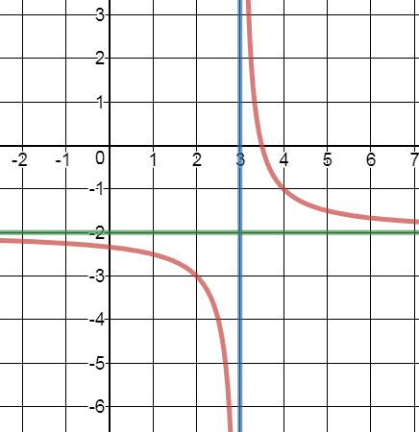
Write the Equation

Slide 3
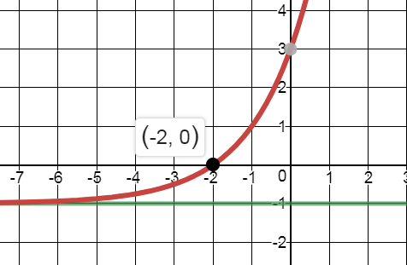
Write the exact equation with the given asymptote & locater point
y = -1

Slide 4
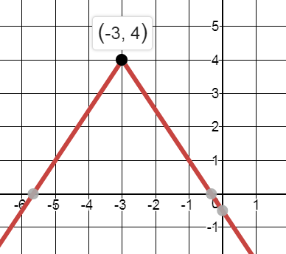
Write the exact Equation

Slide 5
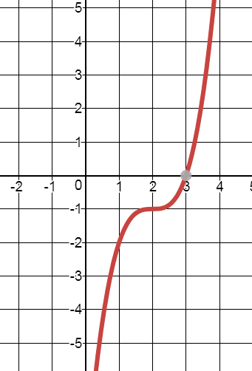
Write the Equation

Slide 6
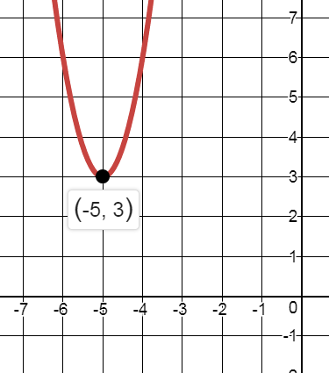
Write the exact Equation

Slide 7
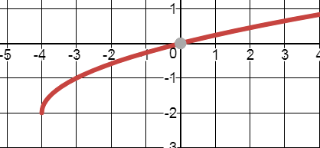
Write the Equation

Slide 8
Solve for x

Slide 9
Write the exact equation of the path of the ball if it is thrown 40 feet and reaches a height of 8 feet.

Slide 10
Write the equation of an absolute value graph with a vertex of (-2,5) and passes through (3,-1)

Slide 11
What translation is applied to to get

Slide 12
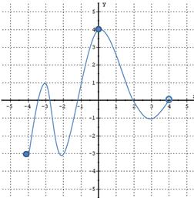
What is the domain of the function?

Slide 13
Complete the square to put in graphing form

Slide 14
What is the domain of:

Slide 15
What is the domain of:

Slide 16
What is the domain of:

Slide 17
Sam bought a house for $540,000. It appreciates 3% a year. How much is it worth after 8 years?

Slide 18
Find the Interquartile Range (IQR)

Slide 19
Find the vertex

